Slide 1

Capstone 2
Kaggle Home Prices Challenge

Slide 2

Overview
Competition Description
Ask a home buyer to describe their dream house, and they probably won't begin with the height of the basement ceiling or the proximity to an east-west railroad. But this playground competition's dataset proves that much more influences price negotiations than the number of bedrooms or a white-picket fence.
With 79 explanatory variables describing (almost) every aspect of residential homes in Ames, Iowa, this competition challenges you to predict the final price of each home.
Practice Skills
Creative feature engineering
Advanced regression techniques like random forest and gradient boosting
Acknowledgments
The Ames Housing dataset was compiled by Dean De Cock for use in data science education. It's an incredible alternative for data scientists looking for a modernized and expanded version of the often cited Boston Housing dataset.

Slide 3

The Data
The data consisted of two datasets.
Test.csv
1452 Listings
82 columns/features
43 strings/categorical data
35 integers
3 float64
Train.csv
Same columns w/o the Sale Price data

Slide 4

The approach
Data Cleaning
Exploratory Data Analysis
Algorithm testing
The Final product

Slide 5

Data Cleaning
Categories with NA values
LotFrontage 259
Alley 1369
MasVnrType 8
MasVnrArea 8
BsmtQual 37
BsmtCond 37
BsmtExposure 38
BsmtFinType1 37
BsmtFinType2 38
Electrical 1
FireplaceQu 690
GarageType 81
GarageYrBlt 81
GarageFinish 81
GarageQual 81
GarageCond 81
PoolQC 1453
Fence 1179
MiscFeature 1406
Categories with NA values
LotFrontage 259
Alley 1369
MasVnrType 8
MasVnrArea 8
BsmtQual 37
BsmtCond 37
BsmtExposure 38
BsmtFinType1 37
BsmtFinType2 38
Electrical 1
FireplaceQu 690
GarageType 81
GarageYrBlt 81
GarageFinish 81
GarageQual 81
GarageCond 81
PoolQC 1453
Fence 1179
MiscFeature 1406
Look for errors in data collecting
1st NA values
2nd Obvious errors
Data that doesn’t make sense
3rd Common errors
Wrong Date/Time
Missing categorys
Wrong dType
Type=none
Area=344
Notes:
Electrical = Na Had to get rid of it
Masonry Veneer Type & Area. Got rid of them.
Alley, Fireplace and Garage were kept because looking at the key NA was intended to state none present, so it wasn’t missing data
Misc, Feature were too sparse so they too were removed.
Pool Quality and Fence quality were kept despite having many NA values because they are generally thought to affect the price of homes significantly.
Year, month and home types and the other data were checked to see if they all conformed with the numbers and classes outlined in the feature explanations.
MasVnrArea 4 had type = None but had areas from 1-344 sqft. Those were dropped. As the data was not properly added and I couldn’t tell if it’s because there ware really no masonry veneer or if the square footage was not correct.
In addition there were two homes which listed they had a type of masonry veneer but had an area of 0. Those had to go too.
After that I could fill in the Na’s in area of the MasVnrArea with 0’s because they were truly 0’s. Now I have no NA’s for MasVnrArea
Lastly type errors were tested to make sure numbers were numbers and text was text. It ended up being remarkably clean in these regards.

Slide 6
Added new data “Neighborhood Price”
Took the average home sale price in each neighborhood for the 5 years listed
Made a new column with the data and saved it to reference if new data comes in.
There were some years where no homes were sold in that year
I tried two methods of filling in the data
Mean sales price for all the years (appeared to be more accurate overall as prices go up and down)
Linear projection of the sales price

Slide 7


Exploratory Data Analysis

Slide 8
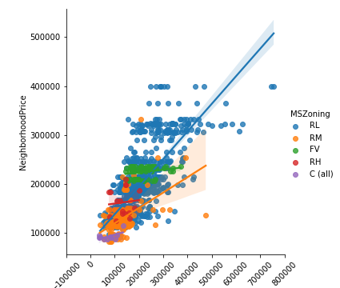
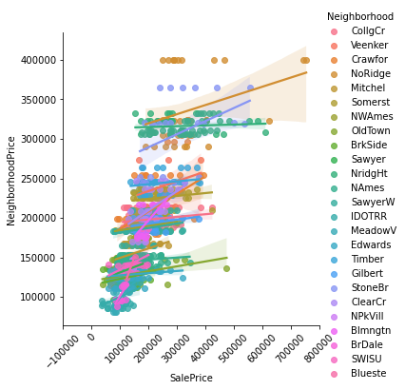
Prices by category
Notes:
This was a mess… didn’t tell me anything!

Slide 9
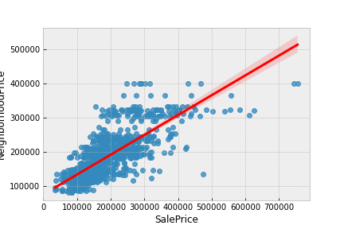
Neighborhood vs Sale Price

Slide 10
Data structure
Categorical Data
Dummy Variables
ID | Neighborhood
1 | NAmes
2 | CollCreek
3 | Venkeer
ID | Neighborhood
1 | 0
2 | 1
3 | 2
ID | Neighborhood
1 | NAmes
2 | CollCreek
3 | Venkeer
ID | Neighborhood_NAmes | Neighborhood_CollCreek
1 | 1 | 0
2 | 0 | 1
3 | 0 | 0
Notes:
I tested out both data structures because some algorithms preform better with one structure vs another.

Slide 11
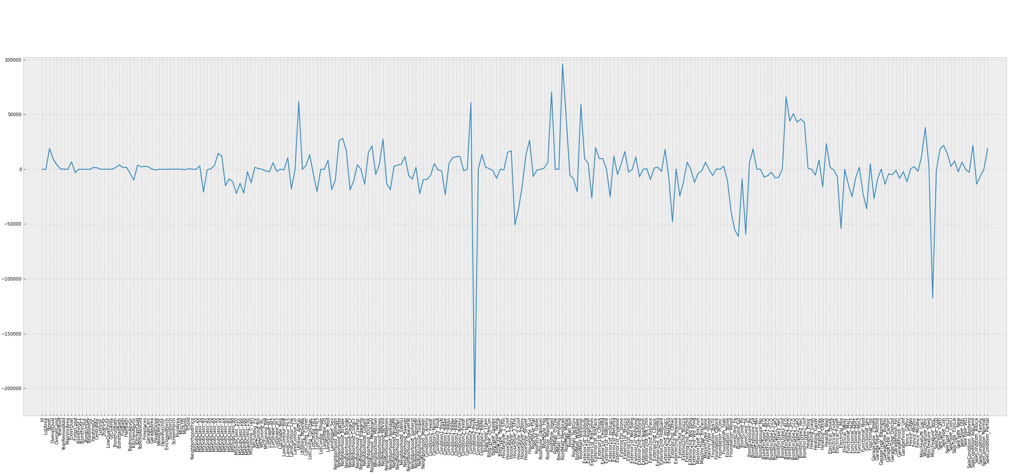
Lasso Analysis

Slide 12
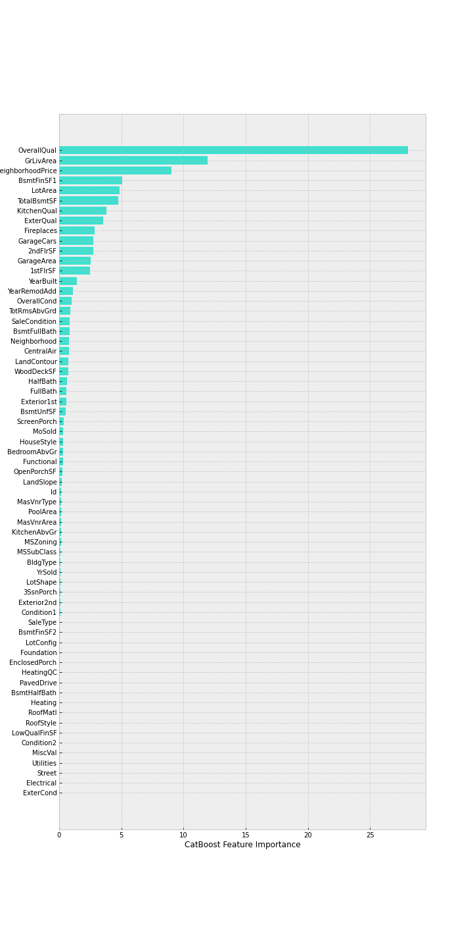
Top 10 Features contributing to home price
N
Notes:
Overall quality
Ground floor living area
Neighborhood price
Square footage of Finished Basement
Size of Lot
Total Square Footage of Basement
Kitchen quality
External home quality
Fireplaces
No. of Cars in garage

Slide 13
Algorithms tried
88.48%
74.37%
98.32%
83.90%
93.00%
Linear Regression
K Nearest Neighbor Regression
Random Forest (Regression)
Gradient Boost (Regression)
CatBoost (Regression) Optomization
Notes:
Linear Regression 88.48%
KNN Regression 74.37%
Random Forest 97.96%
Gradient Boost Regression 83.90%
CatBoost Regression 93.00%

Slide 14
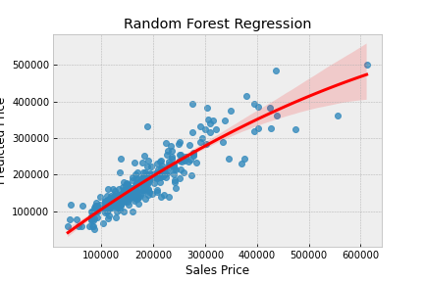
Final Analysis
Accuracy: 98.32%
Predicted Price
Notes:
Linear Regression 88.48%
KNN Regression 74.37%
Random Forest 98.32%
Gradient Boost Regression 83.90%
CatBoost Regression 93.00%

